Slide 1

Survival Score Review and Predictions
Sole Survivor

Slide 2
Agenda
Current Survival Scores
Survival Score Analysis
Predictions

Slide 3

Current Survival Scores

Slide 4
First Impression Survival Score
R^2 ≈ .82
At first glance, with all features, the R^2 is approximately .82 which should indicate the Survival Expert’s score is decent compared to all of the stats collected on the participants.

Slide 5
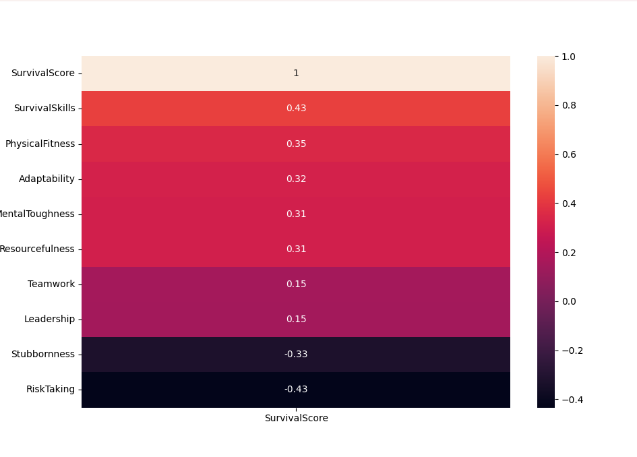
Survival Score vs All Stats
On closer inspection, however, there are traits that do not stand up to being contributing independent variables. This would indicate that some of the stats gathered can be correlated and mean the same thing. Additionally, there are some traits that are far below acceptable correlation coefficients (.3) and must be removed to model the data.

Slide 6
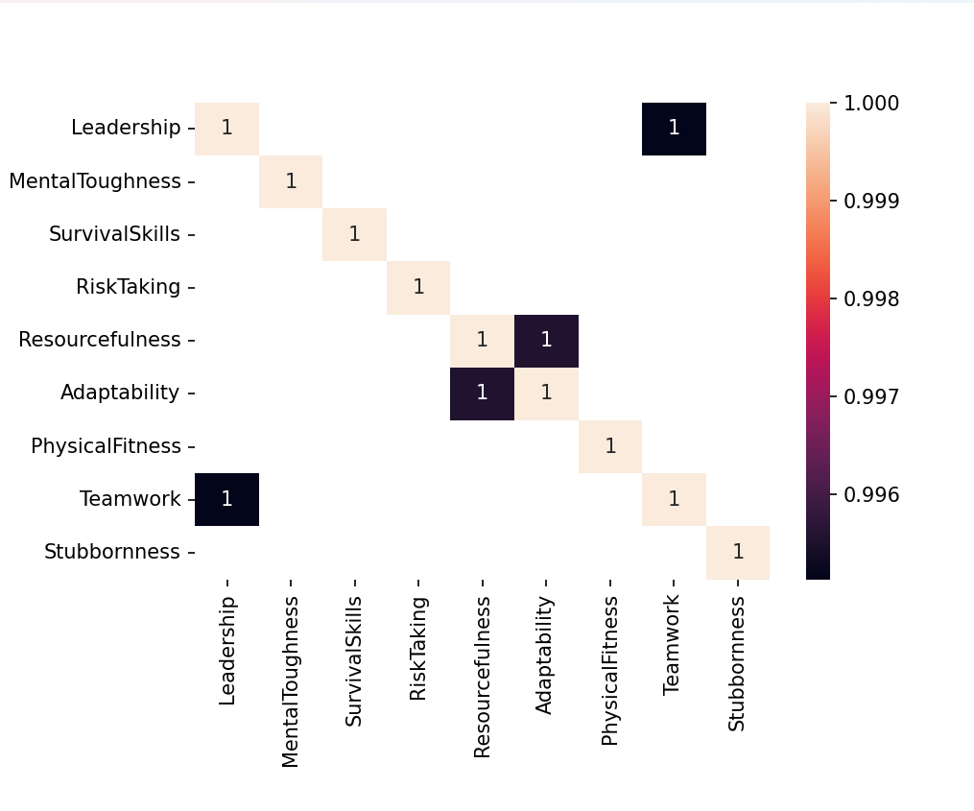
Correlation Between Stats
Looking at a heat map of all the participant’s stats, there are several strong correlations: Survival Skills vs Risk Taking, Leadership vs Teamwork, and Resourcefulness vs Adaptability. Going forward, of these sets, we will only keep: Survival Skills, Teamwork, and Adaptability in the models.

Slide 7
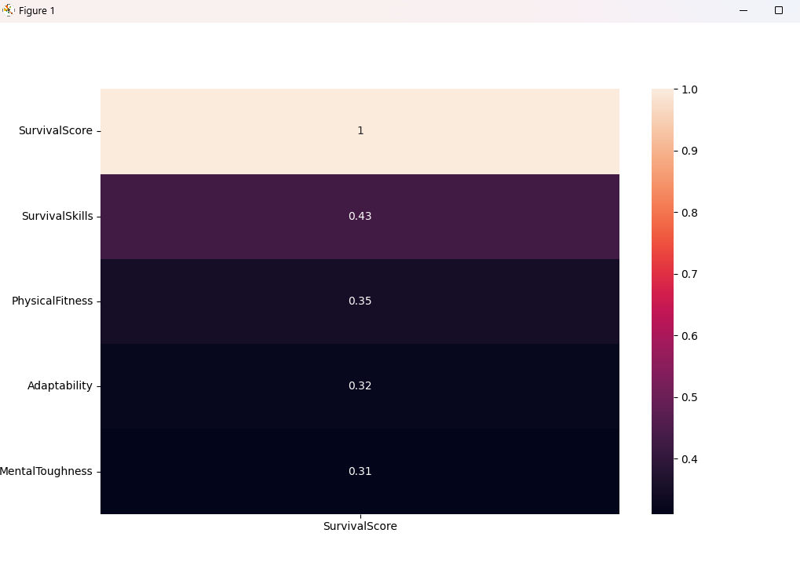
Refined Survival Score vs All Stats
Only four Features stand out as good correlations and predictors of the Survival Score.

Slide 8
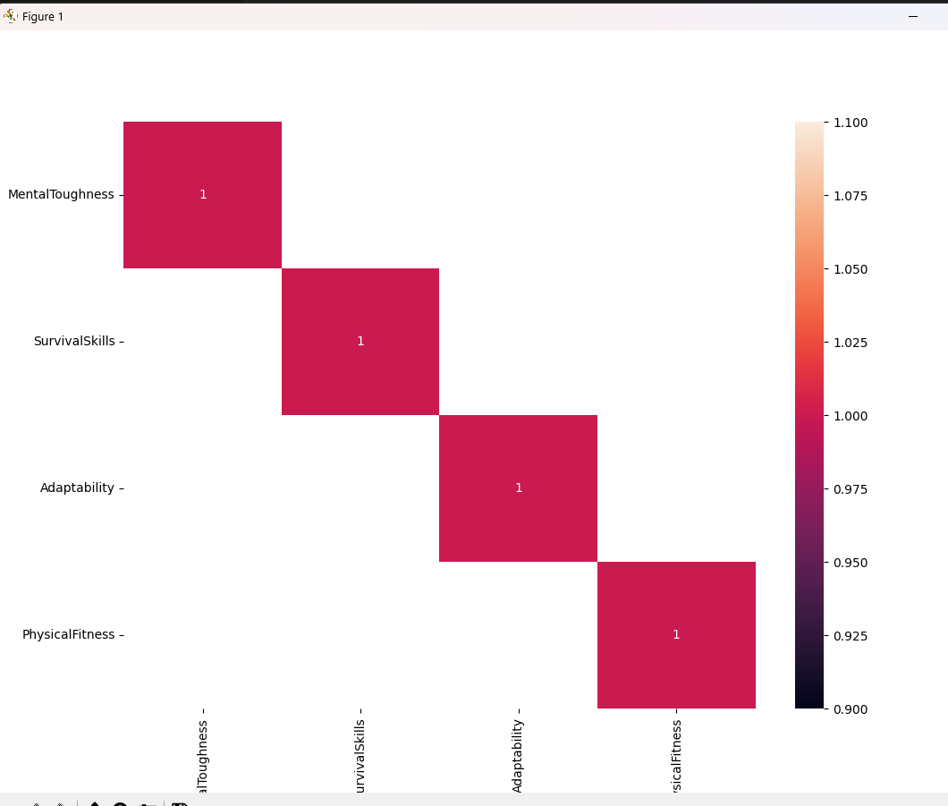
Features Selected
Based on correlation to the response and independence of one another, four features have been kept for the model:
Mental Toughness
Survival Skills
Adaptability
Physical Fitness

Slide 9
Refined Survival Score
R^2 ≈ .57

Slide 10
Did the Survival Specialists score contestants well?
Based on my analysis, I do not believe the survival specialists are scoring the contestants well.
Out of the original nine scoring categories, only four showed meaningful correlation with the survival score. The remaining categories contributed little or no predictive value, suggesting that the specialists’ scoring may be inconsistent or not strongly tied to actual survival outcomes. The need to remove over half the categories to build a reliable model indicates that the scoring system may contain noise or irrelevant criteria.
After feature selection, the model’s R² dropped from 0.82 to 0.56. While 0.56 still reflects a moderate relationship, the decline reinforces the idea that the Survival Score may not be calculated in a way that aligns well with the available features. A well‑constructed scoring system would show more stable predictive performance across different feature sets.

Slide 11
Refined Survival Score
R^2 ≈ .81
With our Feature Selection refined, the R^2 has dropped a hundredth but is still in a good range to pursue future predictions.

Slide 12
The NEXT Survivors

Slide 13
RMSE of Future Survivalists
RMS ≈ 11
We would anticipate a margin of 11 between the actual and predicated Survival Scores of the Future Survivalists.

Slide 14
Predicted Top 3
Nico ≈ 73
Samir ≈ 64
Marisa ≈ 63

Slide 15
Thank you
Jess Nelson
Spring 2026 – Machine Learning

